Slide 1
Light-Brakers
ECEN 1400-012, Group 21
10/22/25

Slide 2




Team Members
Rowan McCune
Electrical Engineering
Hall-Effect Sensor
Jacob Nguyen
Electrical Engineering
LED Array
Mitchell Vallis
Electrical Engineering
Accelerometer
Roman Tagliola
Aerospace Engineering
LCD Display

Slide 3
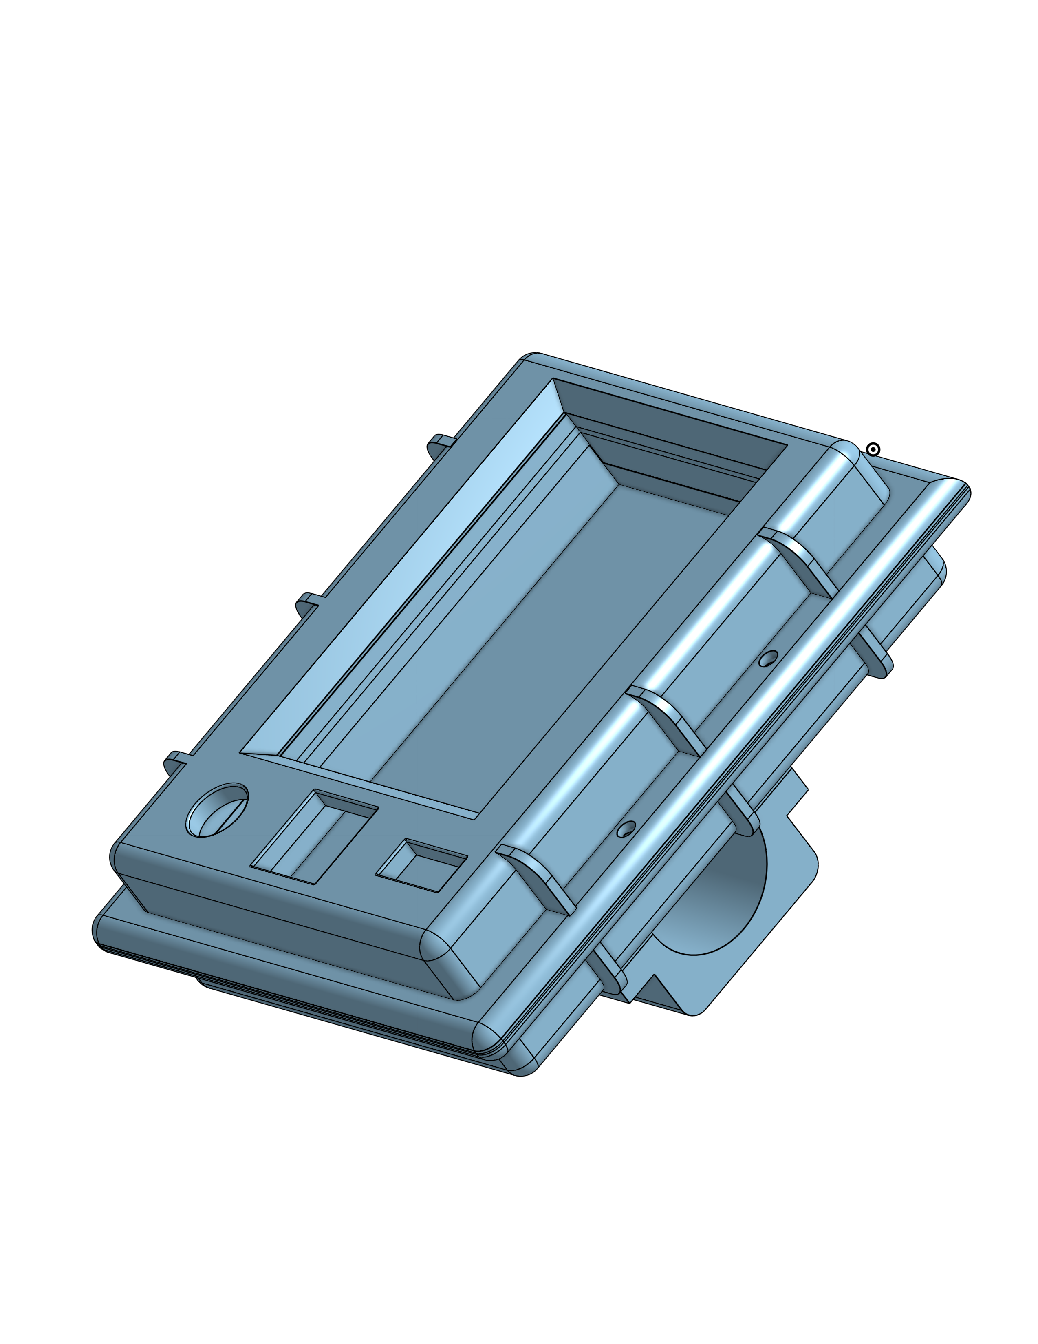
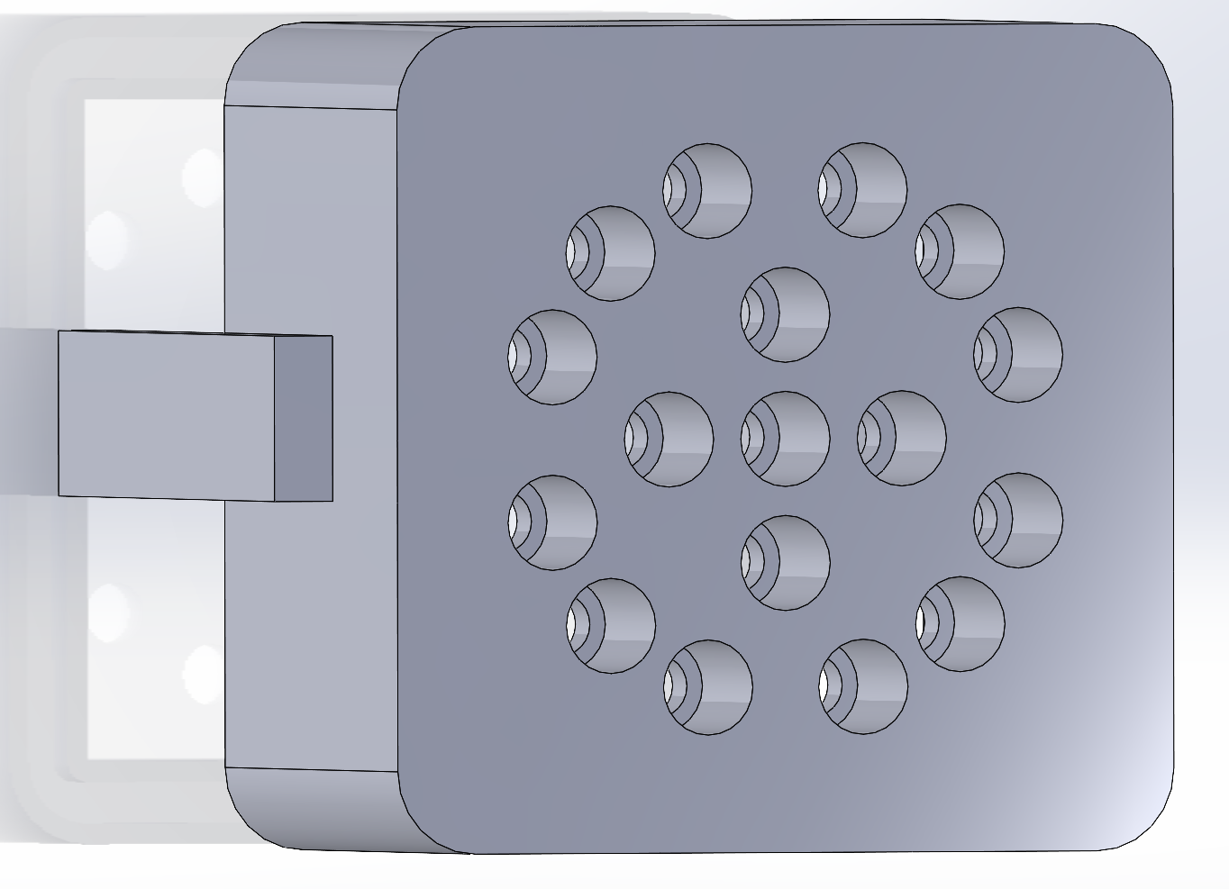

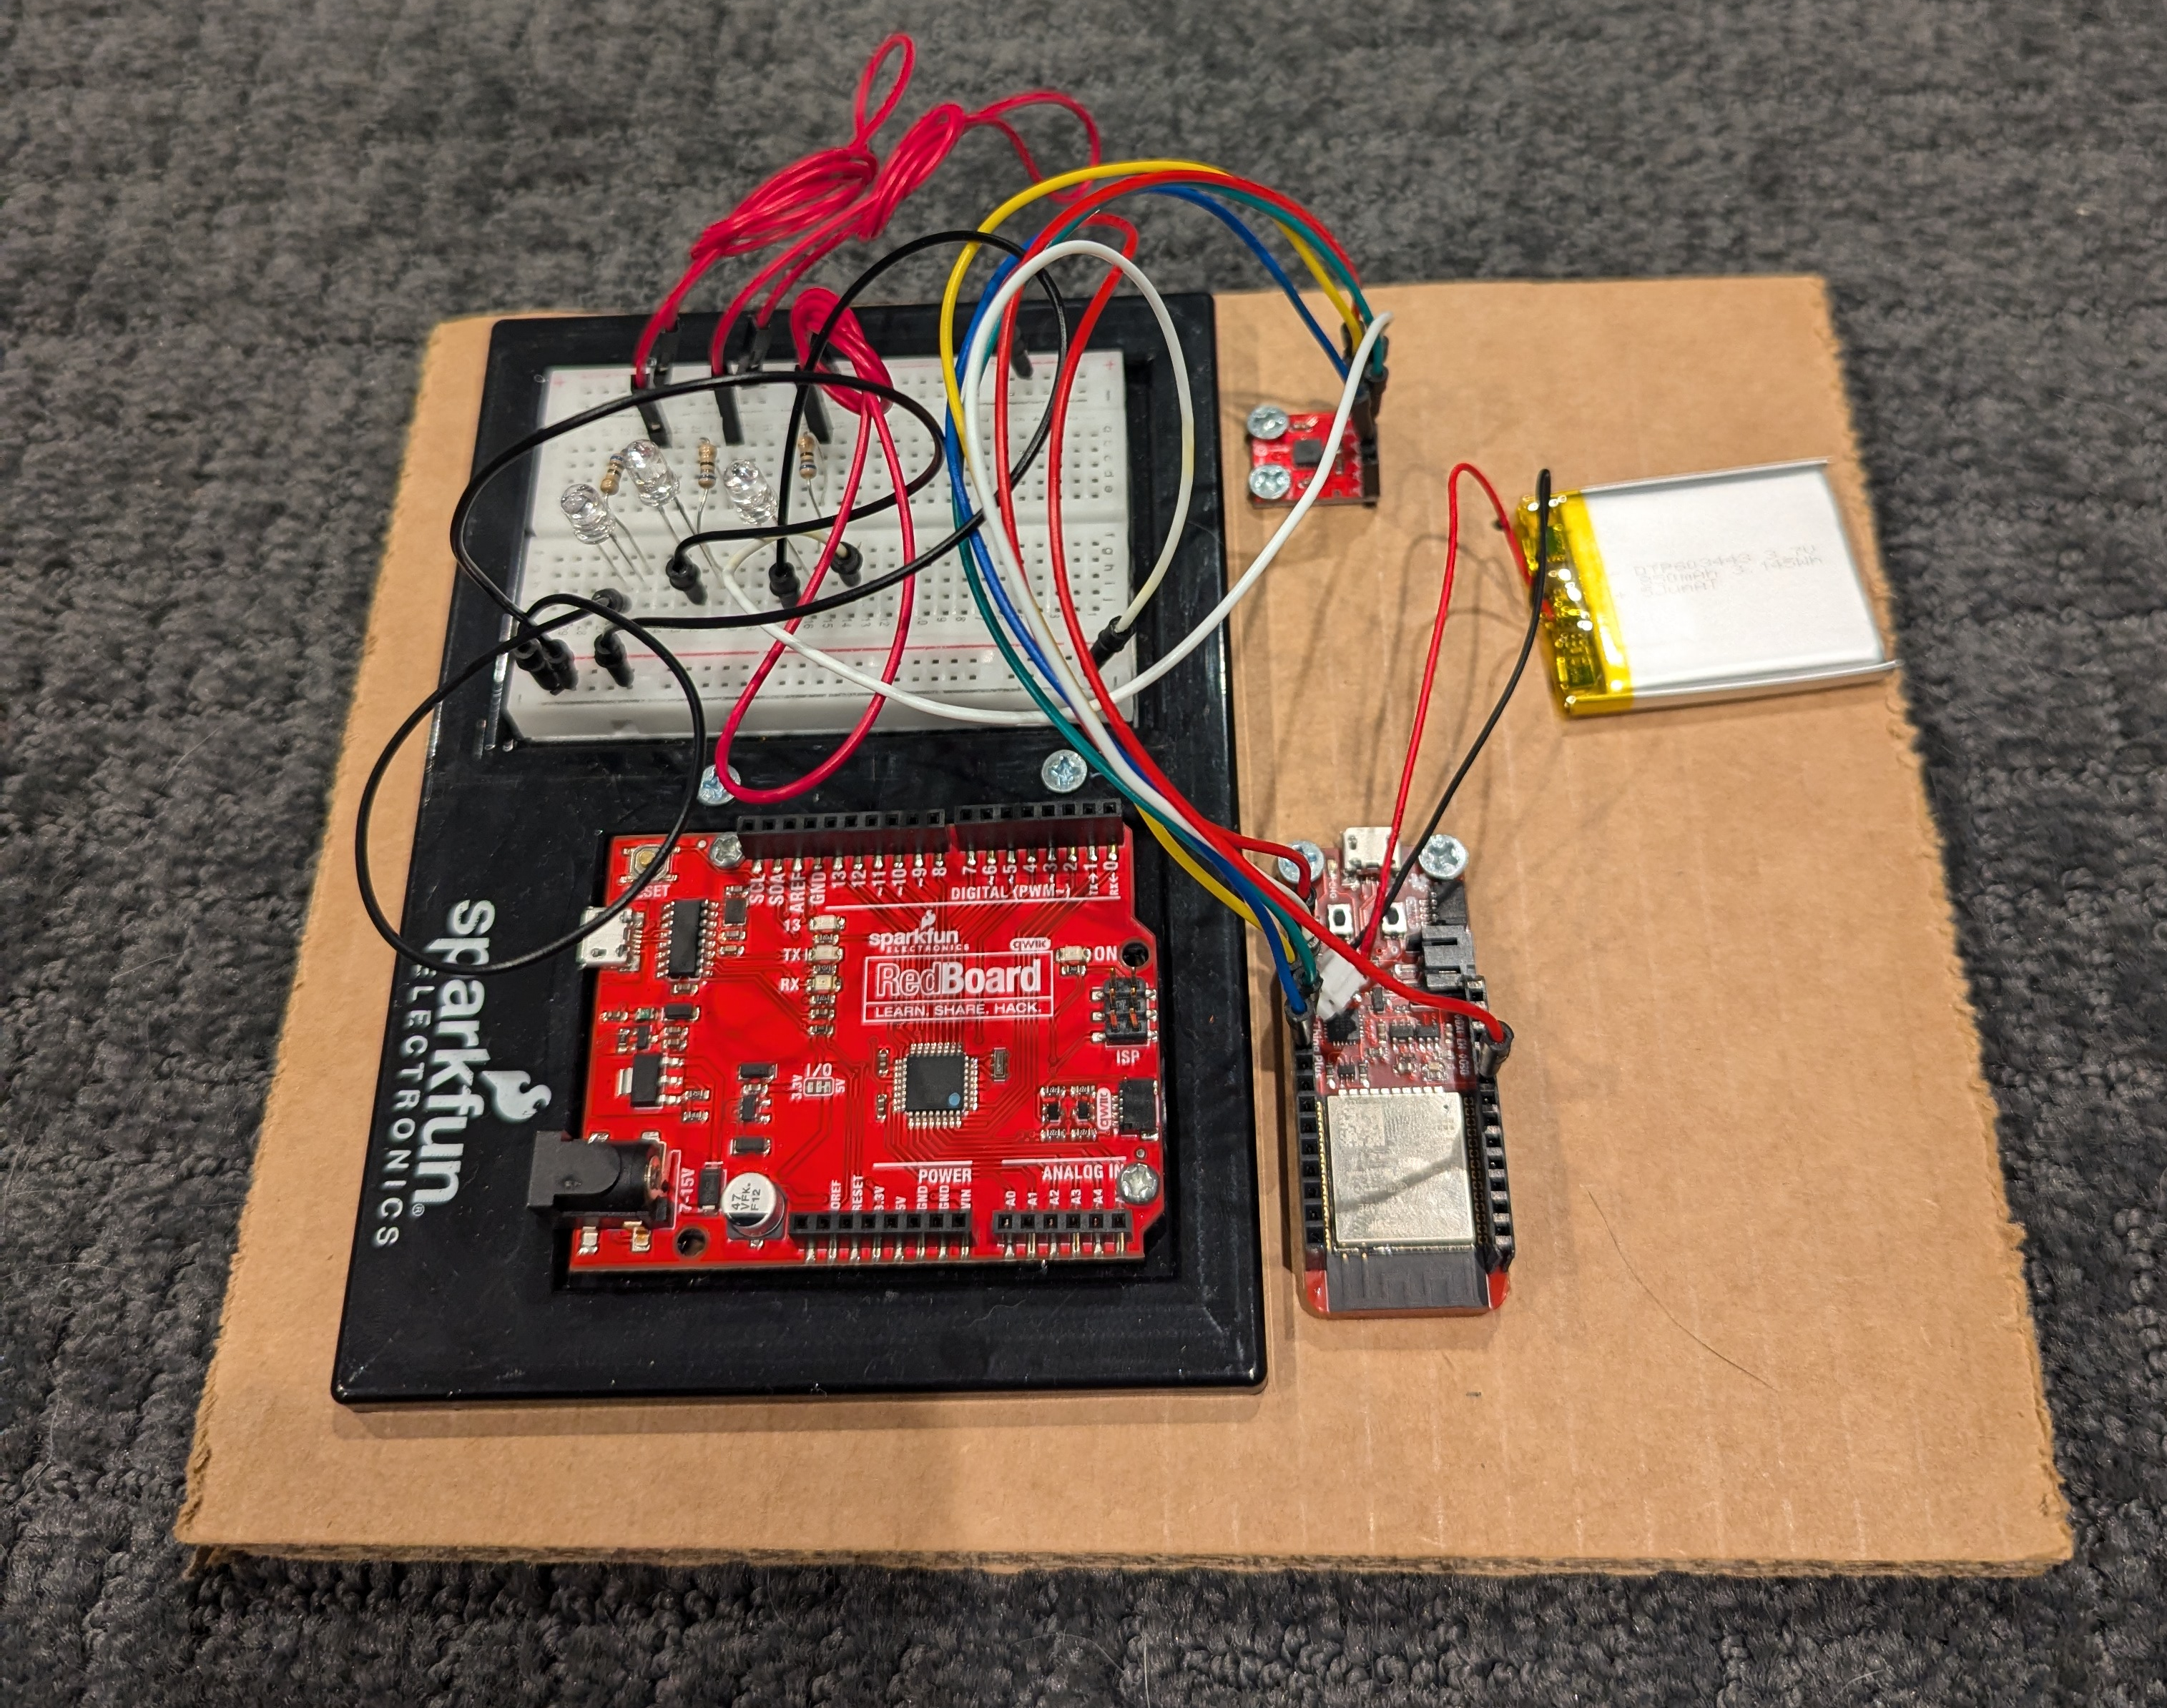
Problem Statement
Bikes generally don’t have a brake light indicating when the cyclist is braking
Congested bike lanes can reduce the rider’s reaction time, leading to crashes

Slide 4
Outline
LED Module Outline
Problem
Concept
Risk Mitigation
Testing
Idea
Display Module Outline
Concept
Risk Mitigation
Testing
Timeline
Bill of Materials
Summary

Slide 5
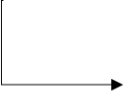
Dynamic Brake Light Software Diagram
Accelerometer
Hall-Effect Sensor
Data collection
Data collection
Controller
Bluetooth
Controller
Process Data
Data
User Interface and Kinematic Computations
LED Array
LCD Display
Light Output
User Configured
Information

Slide 6
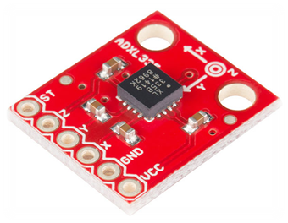
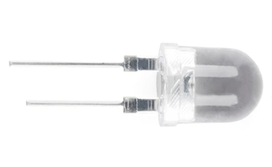
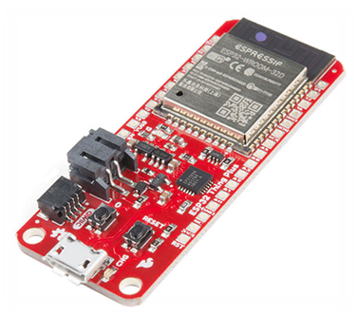
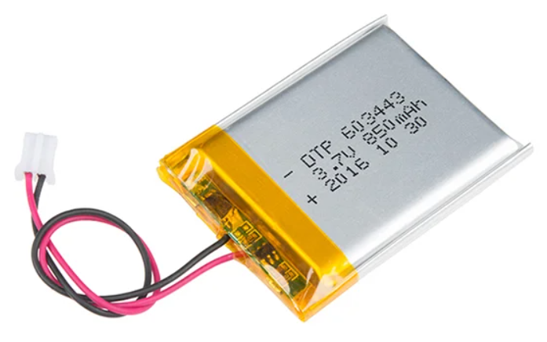
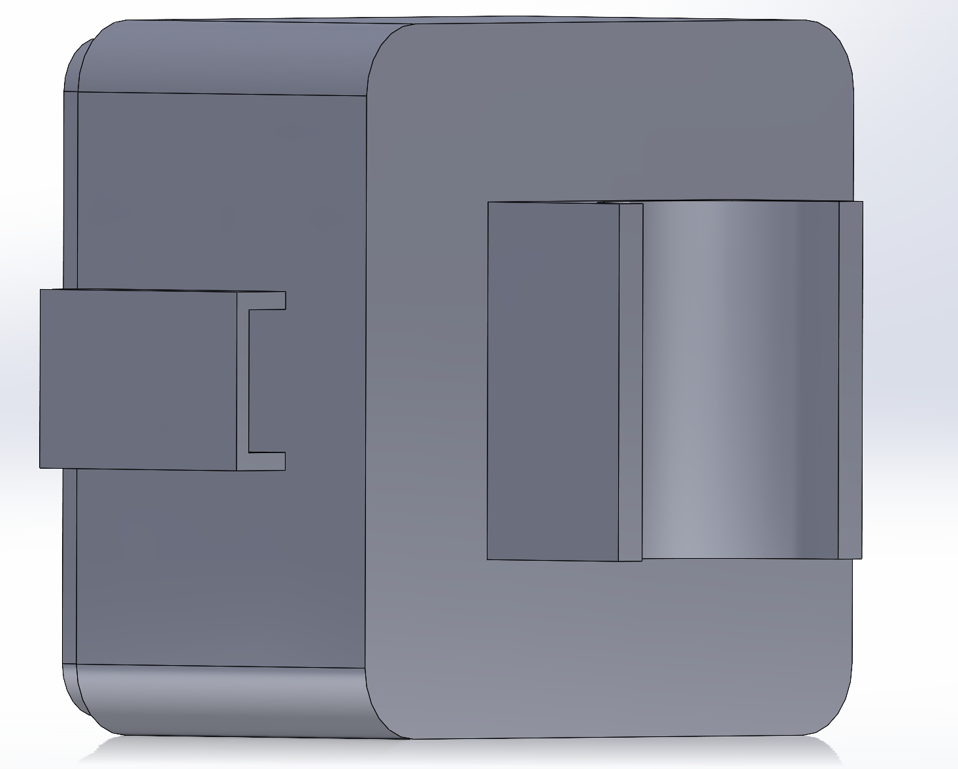
LED Module: Components
Accelerometer
ADXL335
Super Bright Red LED (10000mcd)
ESP32 Thing Plus
Brake Light Casings
Lithium Ion Battery, 850 mAh

Slide 7
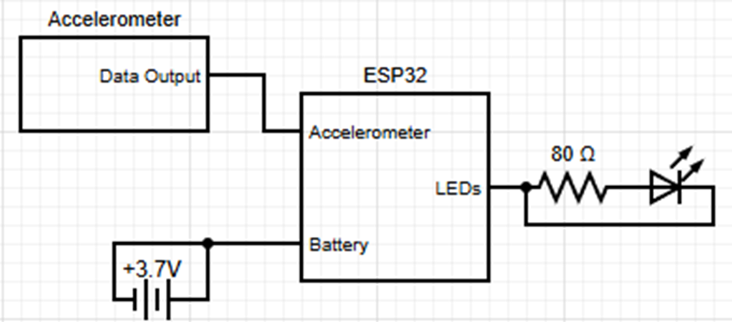
LED Module: Electrical Block Diagram
3.7V 850mAh Lion Battery
17 LEDs in parallel
Power Requirements:
In Parallel, 2.0V to 2.4V
Max Current of 340mA
Up to 10000mcd per
Battery Life: ~4 hours
x17

Slide 8
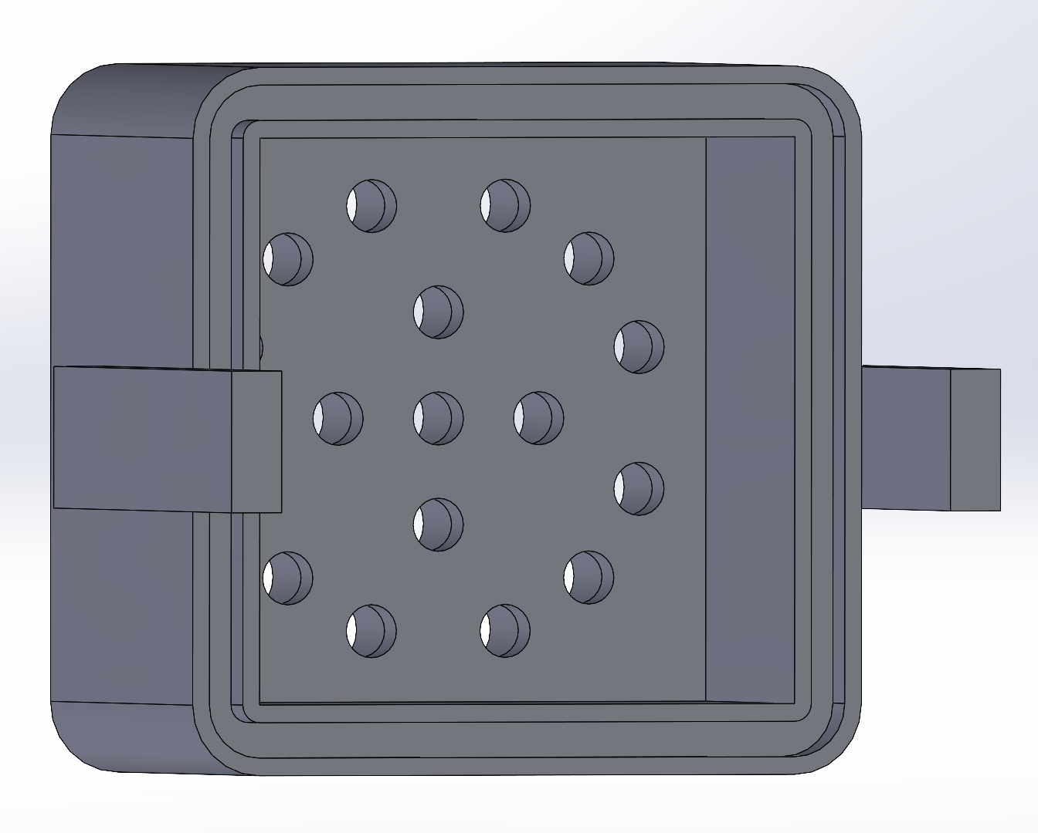
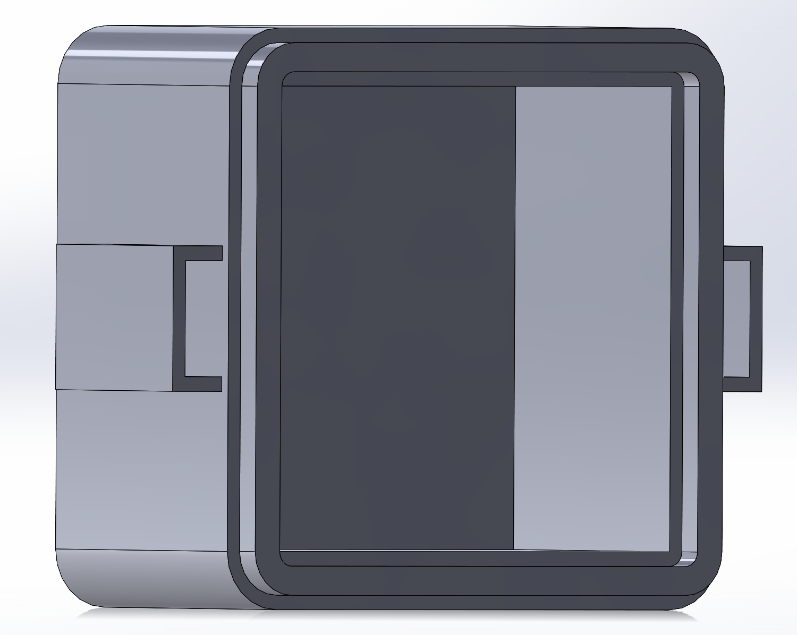
LED Module: CAD Drawings
Front
Back
17 LEDS
Two Pieces
Each 2" x 2" x 1.45"
Inside 1.6" x 1.6" x 2"
Connection:
Slots and Ridges
Accessible USB-C Port
Front has a LED Bulb Hole and a LED Leg Hole
Split Ring Pipe Clamp Attachment

Slide 9
LED Module: Risk Mitigation
Hardware | Software
Circuit damage from vibrations | Ensure light brightness is appropriate to how quickly we are slowing down
Casing not being weather-resistant | Make sure external noise doesn't throw off acceleration measurements
Weak mount / stable attachment to the bike | Issues with connecting to Bluetooth

Slide 10
LED Module: Testing Plan
Hardware | Software
Testing circuit resistance to vibrations and bumps with trial rides | Trial runs on the bike to fine tune brightness of LEDs
Testing casing vibrational resistance and reliability with trial rides | Refine code to reduce noise when accelerometer is mounted
Ensuring zero-tolerance casing fit | Power cycle the brake light to ensure it connects to Bluetooth every time

Slide 11
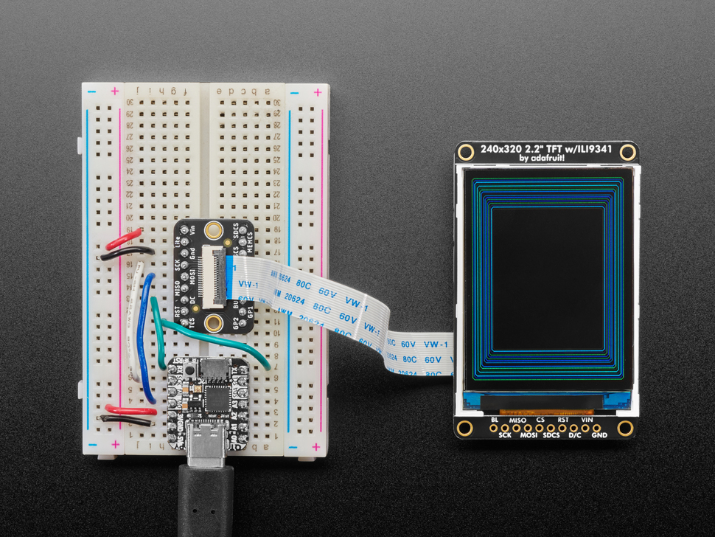
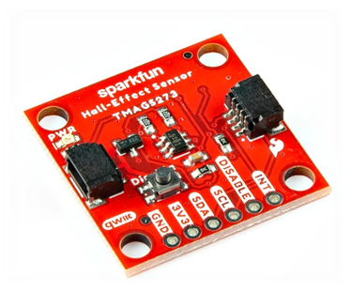
Display Module: Components
ESP32 Thing Plus
Linear 3D
Hall-Effect Sensor
TMAG5273
Lithium Ion Battery, 850 mAh
2.2” Color LCD TFT Display

Slide 12
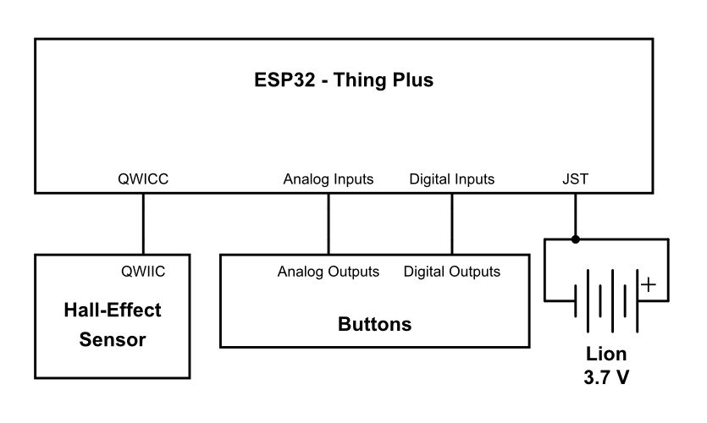
Display Module: Electrical Block Diagram
3.7V 850mAh Lion Battery
Power Requirements:
Total Power: ~0.823W
Current: ~222.3mA
Battery Life: ~3 hours 49 minutes

Slide 13
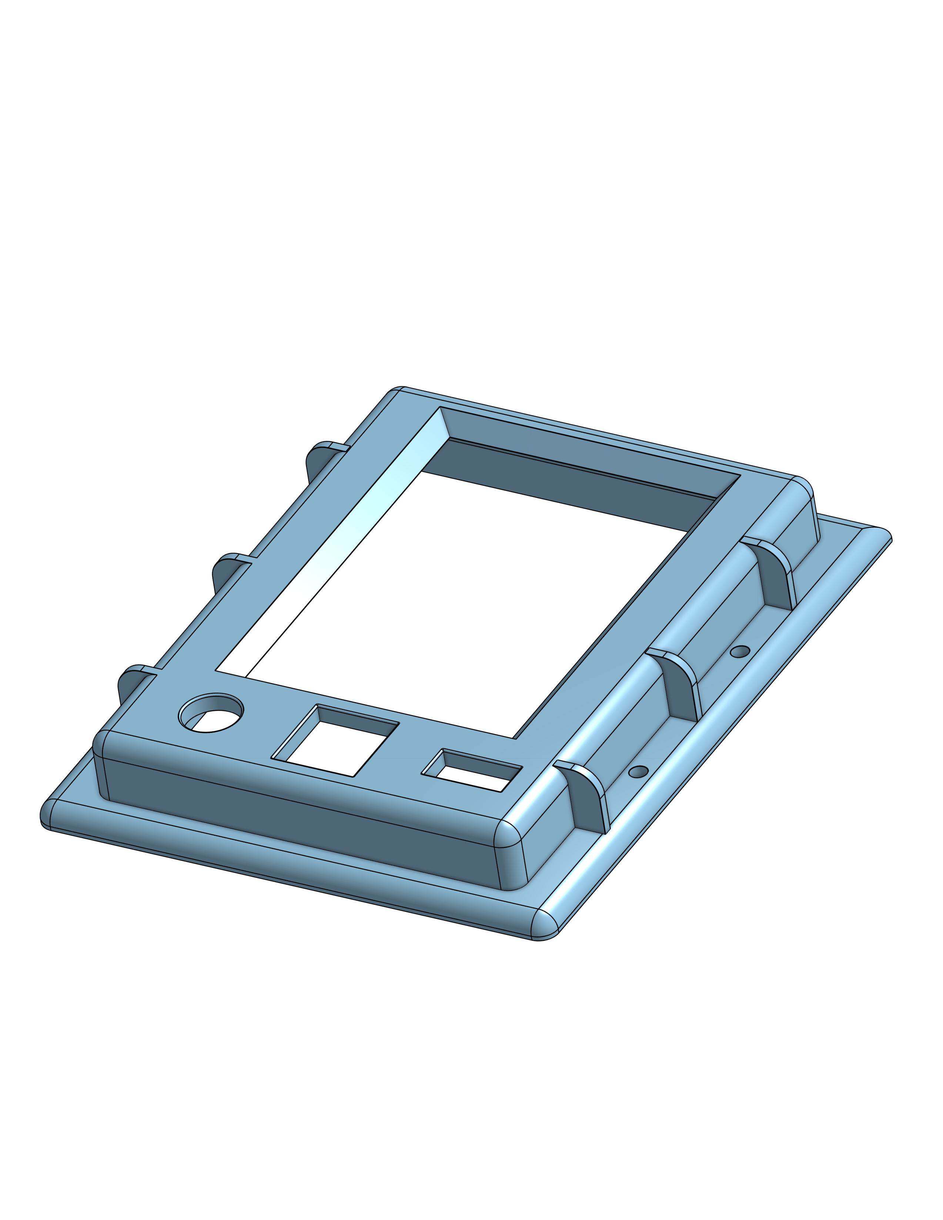
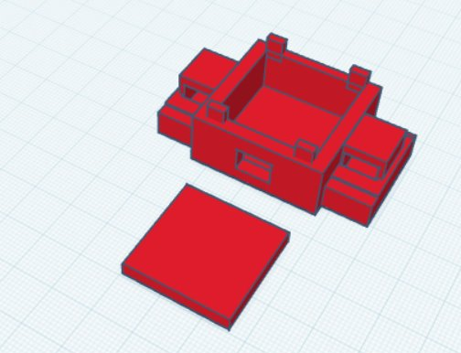
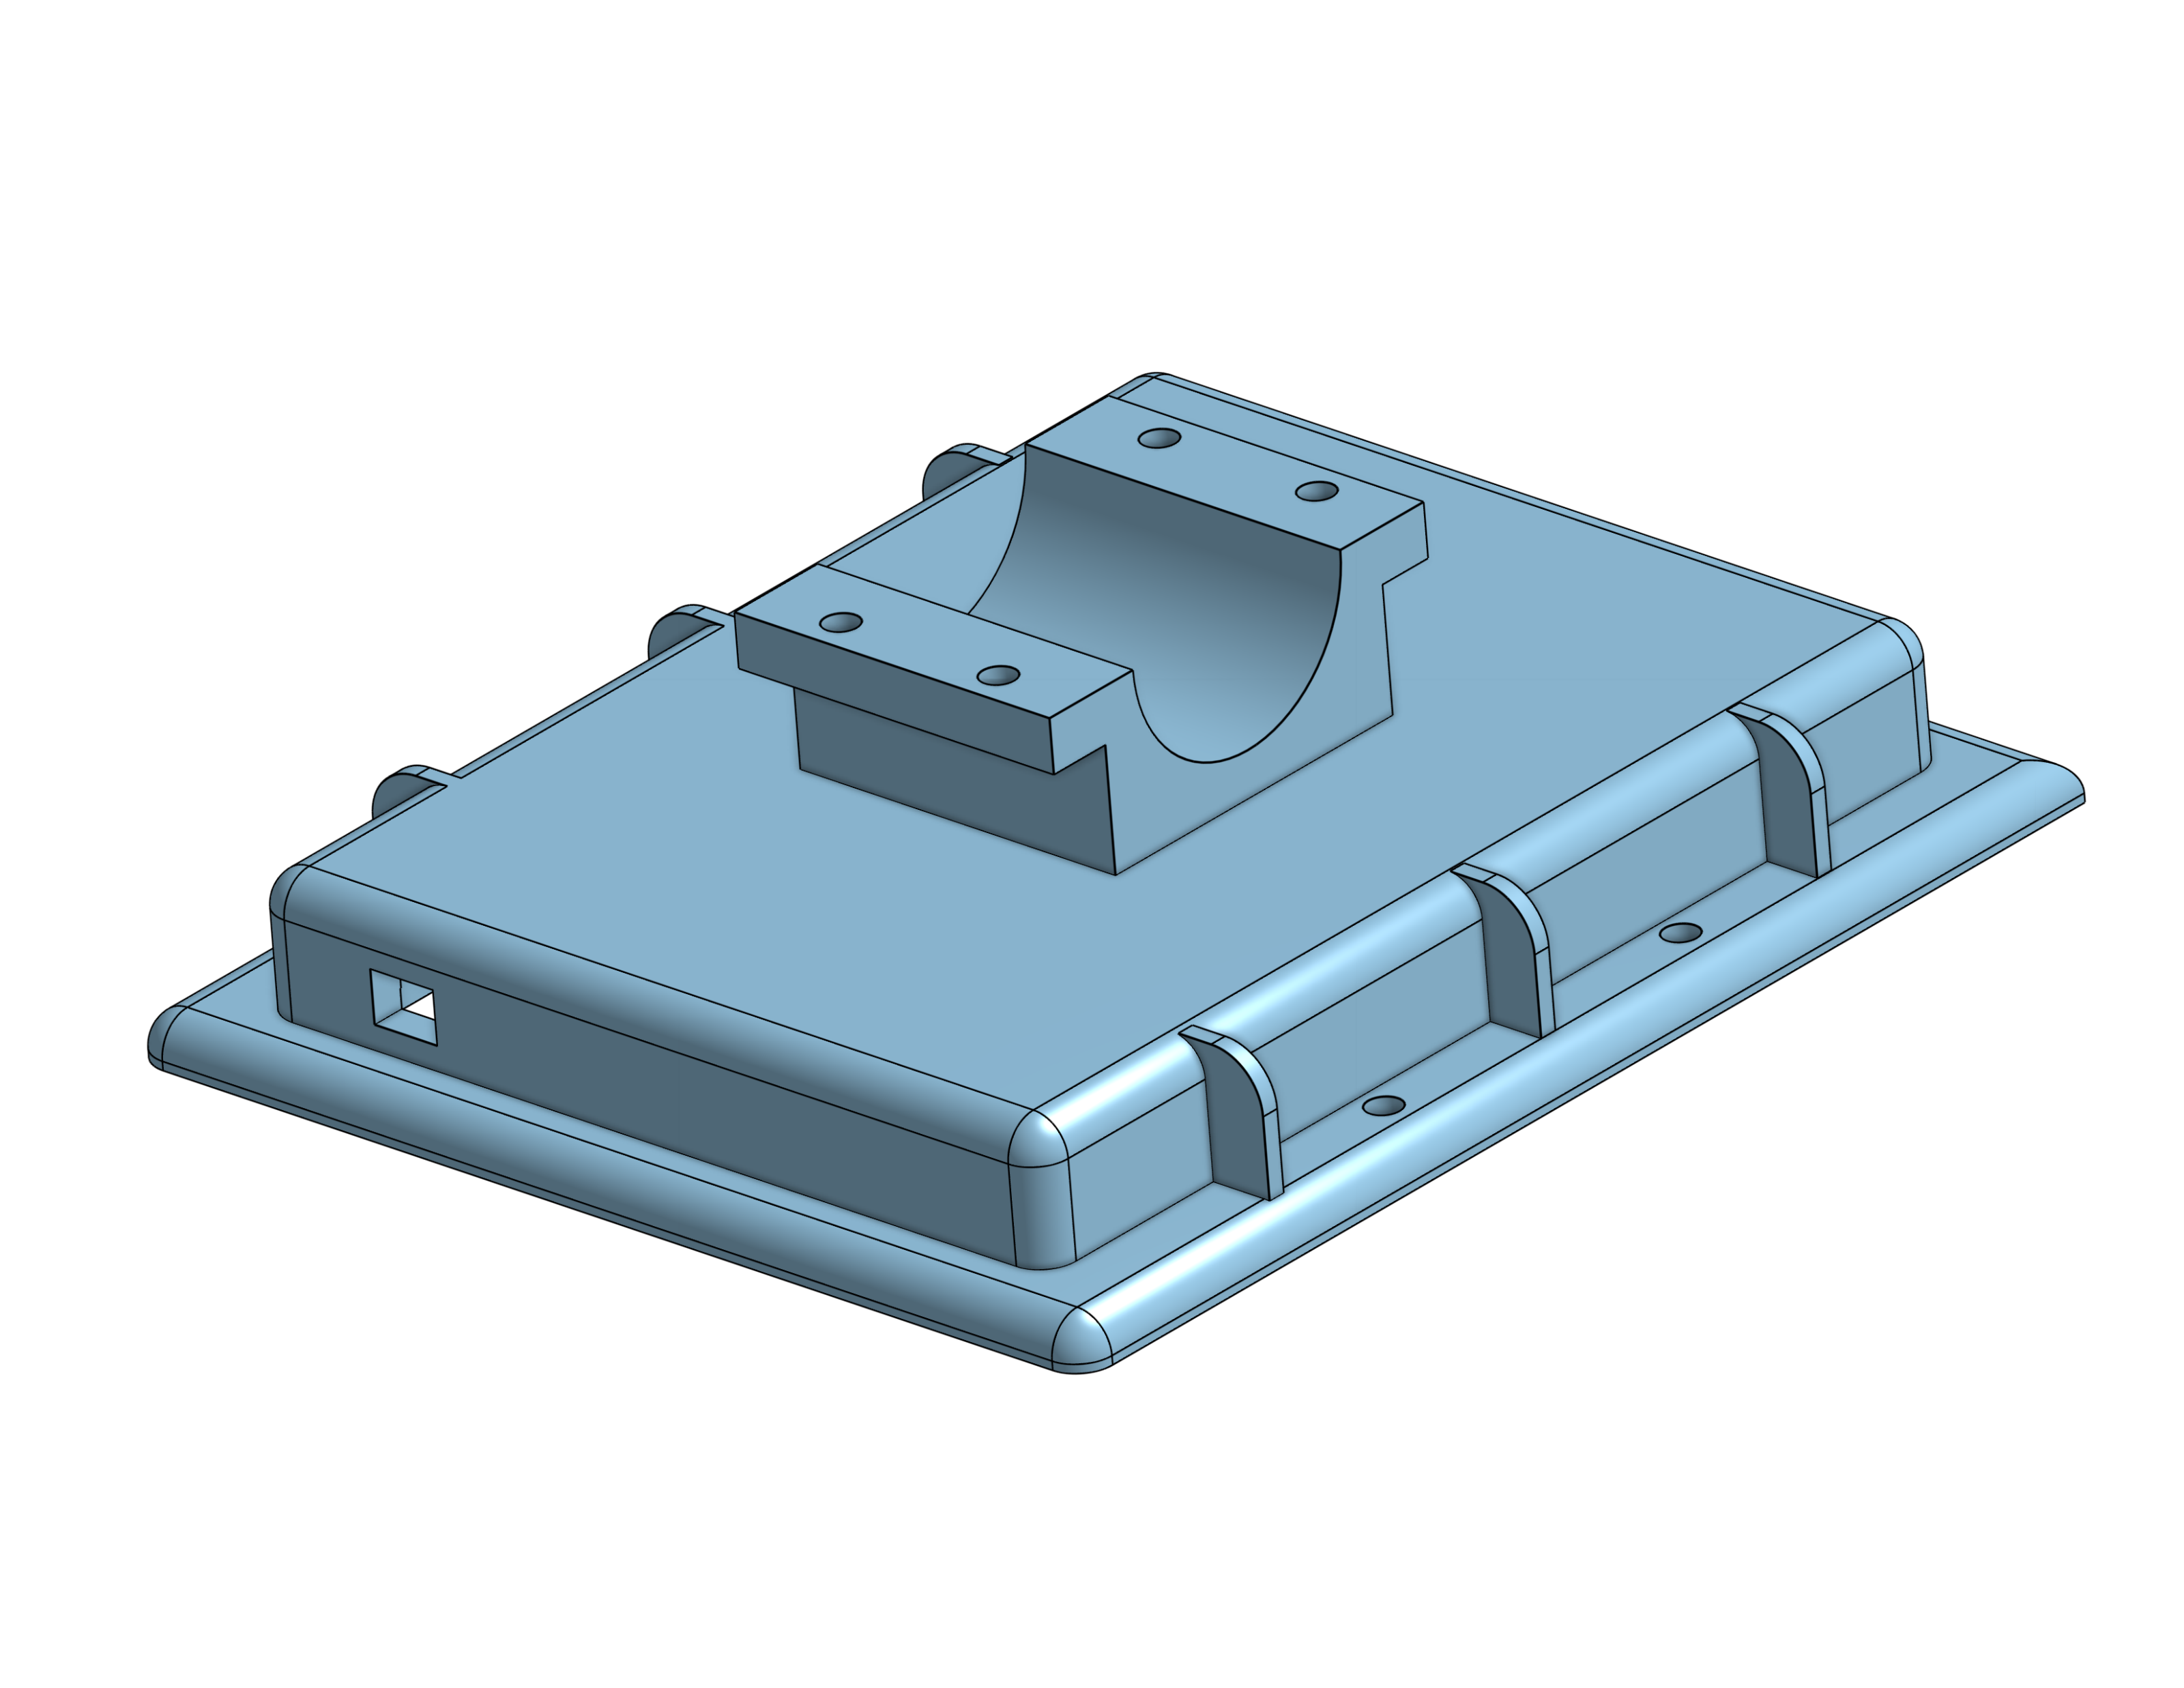
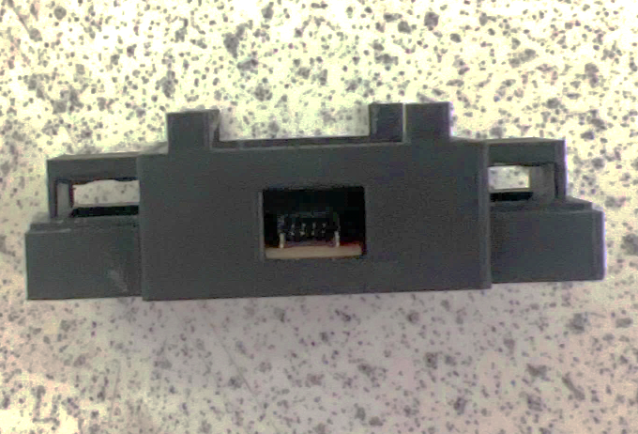
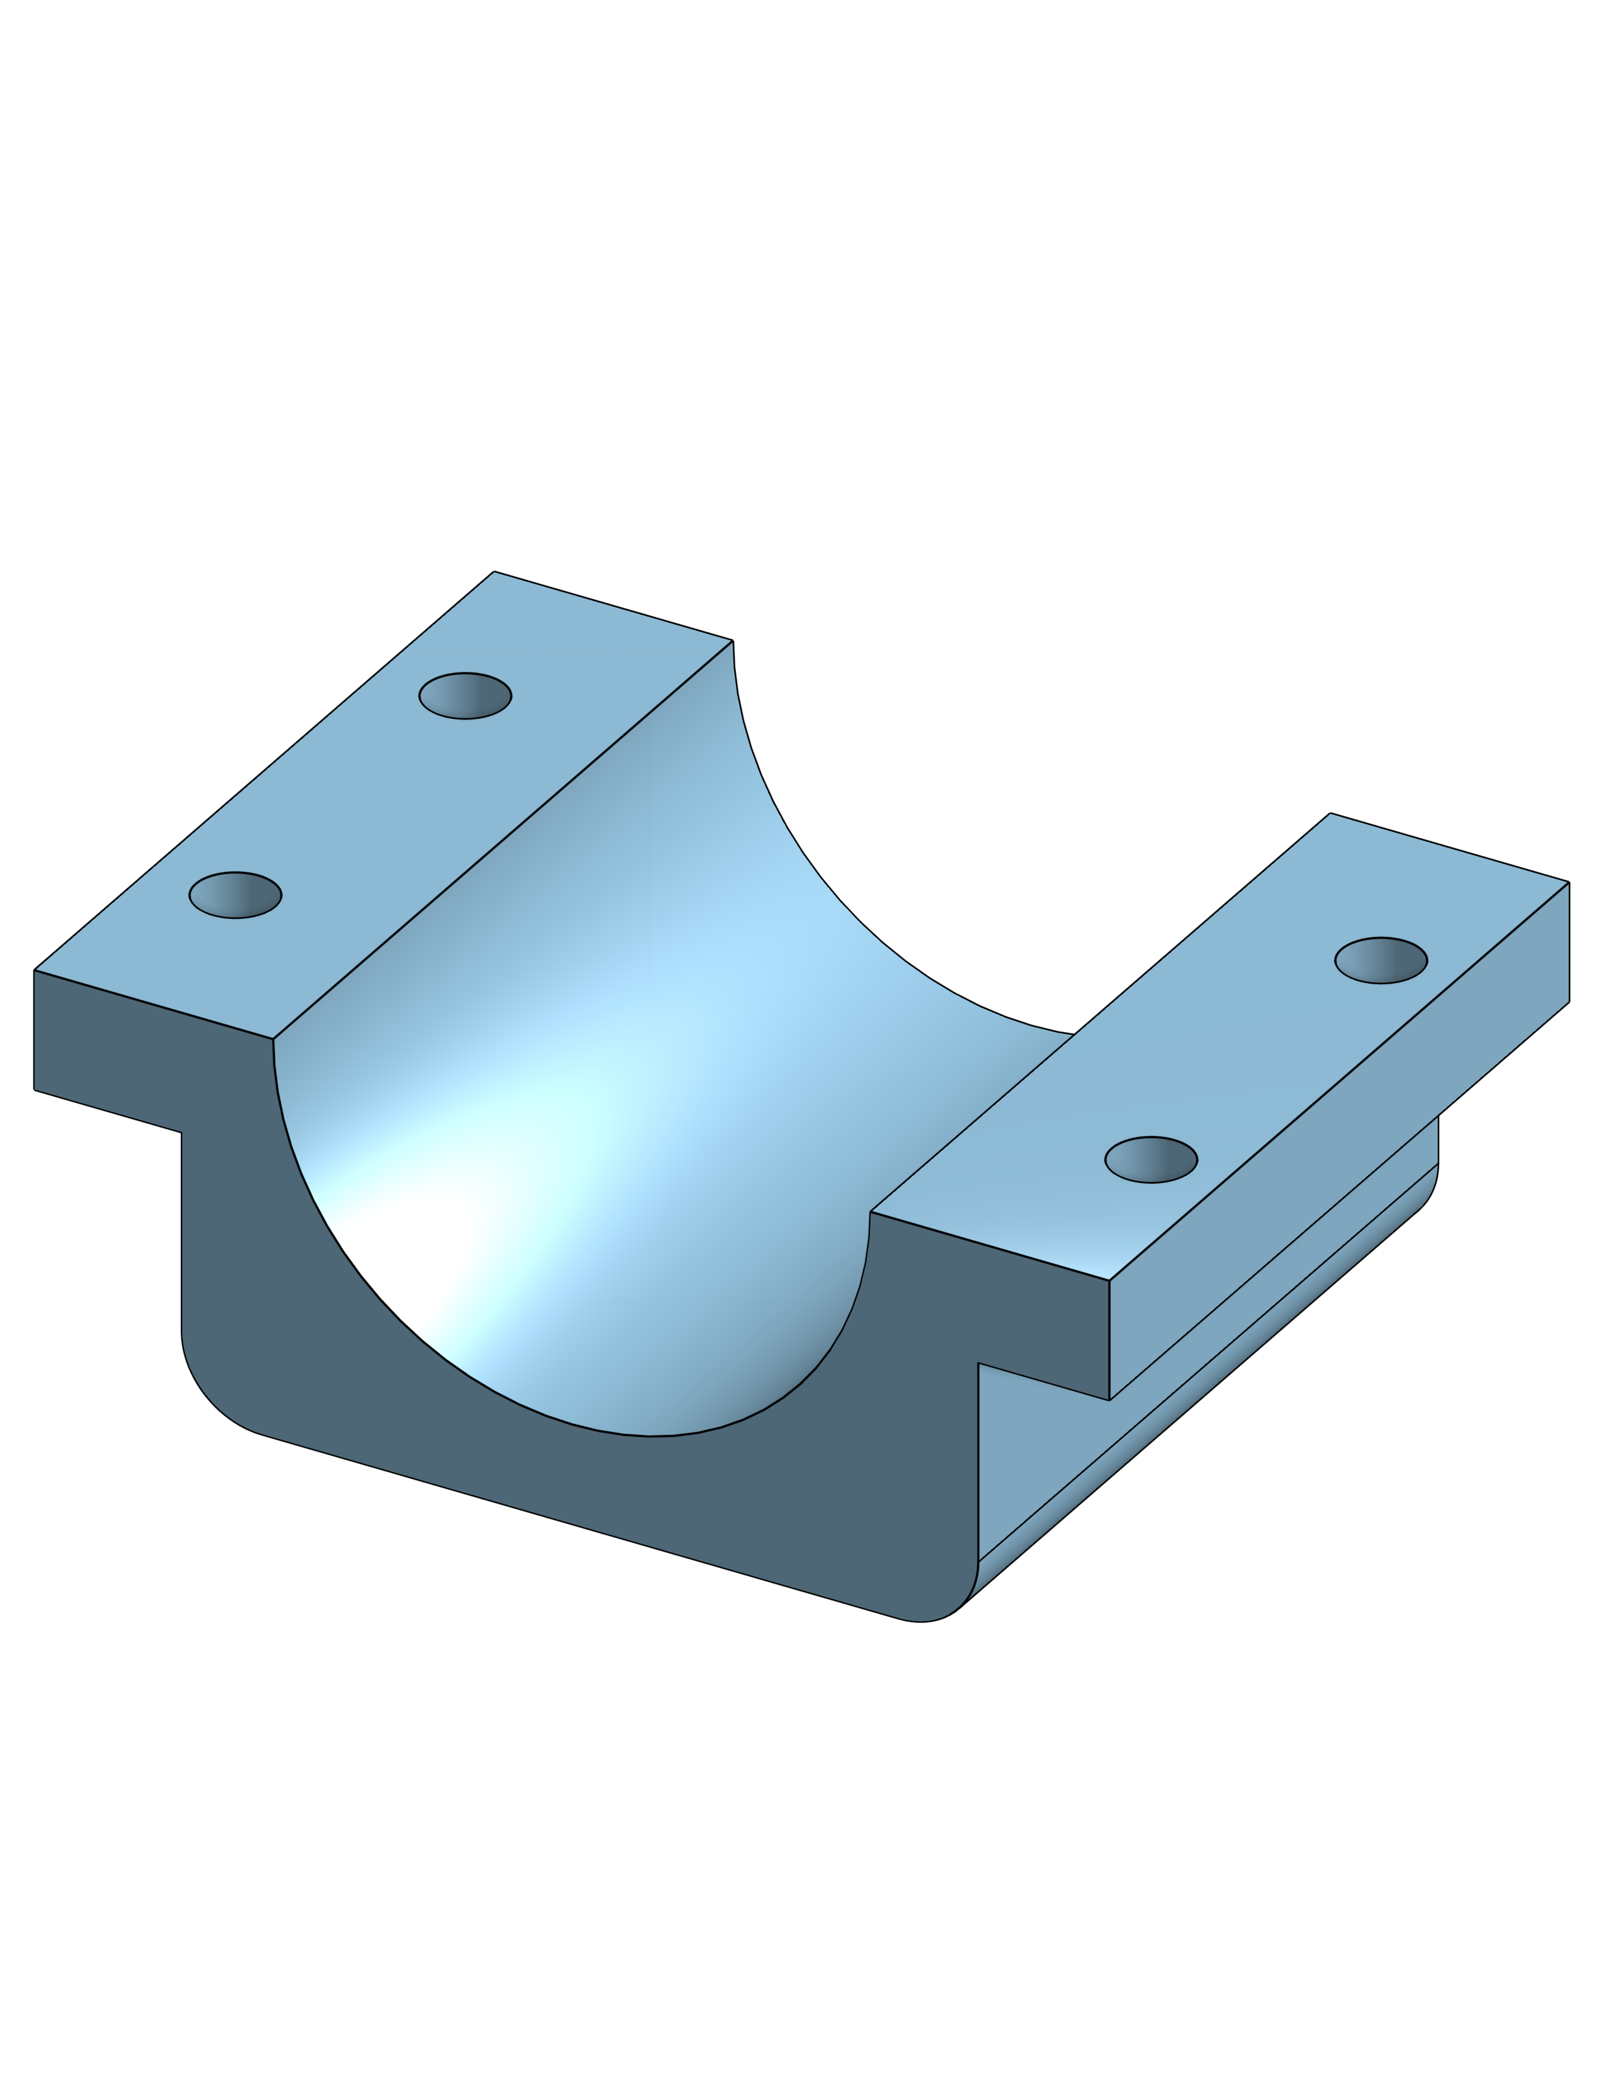

Display Module: CAD Drawings
Prongs that hold module in place
Buttons to adjust display UI
Clamp mount
with interior rubber paint
Zip-tie ports
"Zero-tolerance" weather seal
Clamshell secured by nuts and bolts
Hall-Effect Sensor Housing:
1.0 inches long
2.0 inches wide
0.75 inch tall
Display Module:
1.0 inch thick
(total w/o clamp and buttons)
3.6 inches tall
3.0 inches wide

Slide 14
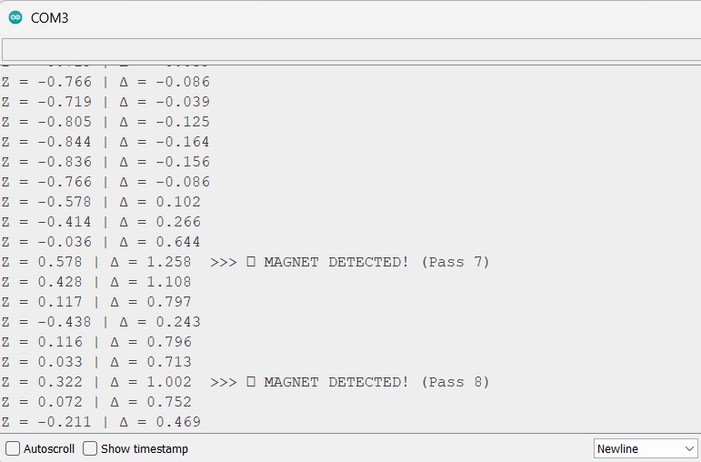
Display Module: Risk Mitigation
Tachometer Sensor Calibration:
Hardware | Software
Original display non-functional out of the box | Intuitive and non-intrusive user interface
Proper fitment of display components inside housings | Stable Bluetooth connection
Circuit damage due to vibrations | Conversion rate and accuracy of Hall-Effect sensor
Magnetic Sensitivity | 1-axis read measurement conversion

Slide 15
Display Module: Testing Plan
Hardware | Software
Mount display module on handle-bar to test stability of mount | Use cardboard plate to test for consistent, stable Bluetooth connections
Ride bike both with the display and with an iPhone to gauge display reading accuracy | Test non-intrusive UI though trial rides
Successfully mount magnets on bike wheel | Track distance travelled with the Hall-Effect sensor and with GPS, measuring accuracy

Slide 16
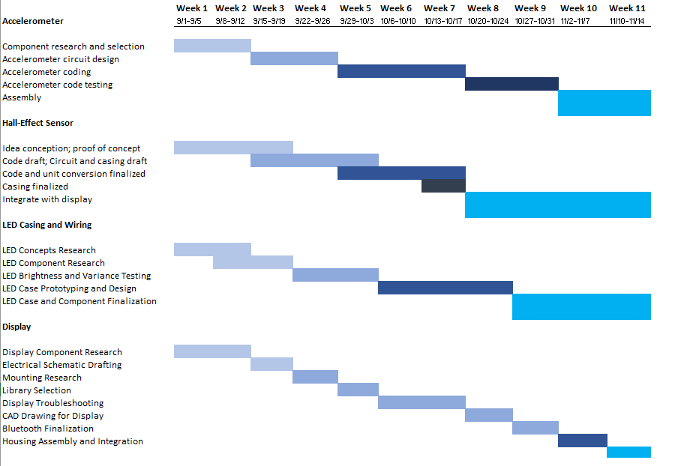
Gantt
Chart

Slide 17
Bill of Materials
Component | Price (USD) | Supplier
SparkFun Triple Axis Accelerometer Breakout | $20 | Amazon
SparkFun Linear 3D Hall-Effect Sensor | $7 | Amazon
LED – Super Bright Red (25 Pack) | $5 | SparkFun Electronics
SparkFun Qwiic Cable Kit | $13 | SparkFun Electronics
SparkFun Capacitor Kit | $12 | SparkFun Electronics
2.2" 18-Bit Color TFT LCD with MicroSD Card Breakout – EYESPI Connector | $25 | AdaFruit Industries
2x SparkFun Thing Plus – ESP32 WROOM (Micro-B) | $25 Each $50 Total | SparkFun Electronics
Total | $132

Slide 18
Summary
Identified a problem in the biking community
Explained our solution to this problem
Reviewed the technical execution of our solution and how each component is implemented
Explained risks, testing plan and project management

Slide 19
Questions?

